Slide 1
Spanning Tree
A spanning tree is any tree that consists solely of edges in G and that includes all the vertices in G.
Example

Slide 2
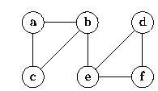
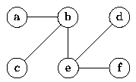
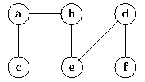
Constructing Spanning Trees
Any traversal of a connected, undirected graph visits all the vertices in that graph. The set of edges which are traversed during a traversal forms a spanning tree.
For example, Fig:(b) shows the spanning tree obtained from a breadth-first traversal starting at vertex b.
Similarly, Fig:(c) shows the spanning tree obtained from a depth-first traversal starting at vertex c.
(a) Graph G
(b) Breadth-first spanning tree of G rooted at b
(c) Depth-first spanning tree of G rooted at c

Slide 3
Minimum cost spanning tree
The cost of the spanning tree of a weighted undirected graph is the sum of the costs of the edges in the spanning tree.
A minimum cost spanning tree is a spanning tree of least cost.
Three algorithms are used to find this
All these assume about the solution following constraints

Slide 4
  We must use only edges of the graph
  We must have exactly n-1 edges
  We may not use edges that would produce a cycle.

Slide 5
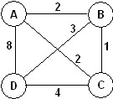
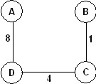
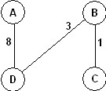
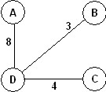
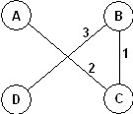
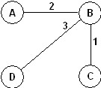
Example Minimum-Cost Spanning Tree
For an edge-weighted , connected, undirected graph, G, the total cost of G is the sum of the weights on all its edges.
A minimum-cost spanning tree for G is a minimum spanning tree of G that has the least total cost.
Example: The graph
Has 16 spanning trees. Some are:
The graph has two minimum-cost spanning trees, each with a cost of 6:

Slide 6
Applications of Minimum-Cost Spanning Trees
Minimum-cost spanning trees have many applications. Some are:
Building cable networks that join n locations with minimum cost.
Building a road network that joins n cities with minimum cost.
Obtaining an independent set of circuit equations for an electrical network.
In pattern recognition minimal spanning trees can be used to find noisy pixels.

Slide 7
Kruskal's Algorithm.
Kruskal’s algorithm finds the minimum cost spanning tree of a graph by adding edges one-by-one.
Algorithm:
T={}
While(T contains less than n-1 edges &&E is not empty)
{
Choose a least cost edge (v,w) from E
Delete (v,w) from E
If((v,w) does not create a cycle in T)
Add(v,w) to T
Else discard (v,w) }
If (T contains fewer than n-1 edges) print no spanning tree.

Slide 8
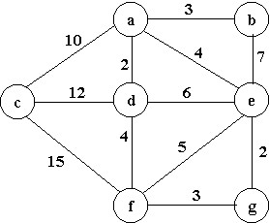
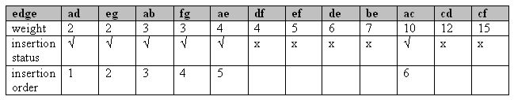
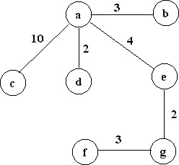
Example for Kruskal’s Algorithm.
Trace Kruskal's algorithm in finding a minimum-cost spanning tree for the undirected, weighted graph given below:
The minimum cost is: 24

Slide 9
Prim’s Algorithm
Prim’s algorithm finds a minimum cost spanning tree by selecting edges from the graph one-by-one as follows:
It starts with a tree, T, consisting of the starting vertex, x.
Then, it adds the shortest edge emanating from x that connects T to the rest of the graph.
It then moves to the added vertex and repeats the process.
Algorithm:
T={}
TV={0} /*start with vertex 0 and no edges*/
While(T contains fewer than n-1 edges)
{ let (u,v) be a least cost edge such that u is in set TV and v is not in TV;
If(there is no such edge) break;
Add v to TV;
Add(u,v) to T;
}
If T contains fewer than n-1 edges print “no spanning tree”.

Slide 10
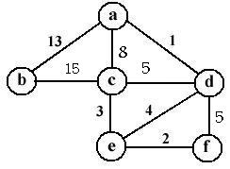
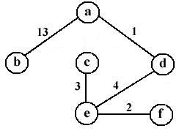
Example
Trace Prim’s algorithm starting at vertex a:
The resulting minimum-cost spanning tree is:

Slide 11
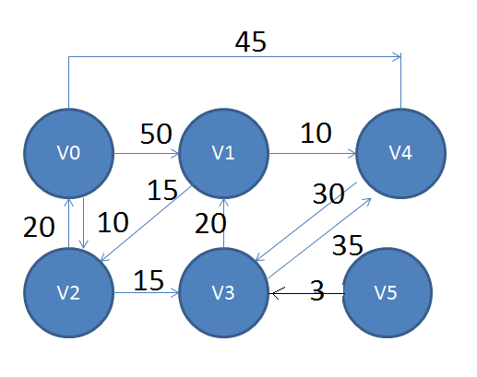
Shortest Path algortithms

Slide 12
Dijikstra’s Algorithm
#define MAX_VERTICES 6
int cost[][MAX_VERTICES]={
{0,50,10,1000,45,1000},
{1000,0,15,1000,10,1000},
{20,1000,0,15,1000,1000},
{1000,20,1000,0,35,1000},
{1000,1000,30,1000,0,1000},
{1000,1000,1000,3,1000,0}};

Slide 13
int dist[MAX_VERTICES];
short int found[MAX_VERTICES]={0};
int n=MAX_VERTICES;
int choose(int dist[],int n,short int found[])
{
int i,min,minpos;
min=32767; minpos=-1;
for(i=0;i<n;i++){
If(dist[i]<min && !found[i]){ min=dist[i];
minpos=i;} return minpos;}

Slide 14
void shortestpath(int v,int cost[][MAX_VERTICES],int dist[],int n,short int found){
/*dist[i] represents shortest path from vertex v to i.found[i] holds 0 if shortest path to vertex i has not been found 1 otherwise.*/
int i,u,w;
for(i=0;i<n;i++){ dist[i]=cost[v][i];}
found[v]=1;dist[v]=0;

Slide 15
for(i=0;i<n-2;i++){
u=choose(dist,n,found); found[u]=1;
for(w=0;w<n;w++)
if(!found[w])
if(dist[u]+cost[u][w]<dist[w])
dist[w]=dist[u]+cost[u][w];
}
}

Slide 16
found | 0 | 0 | 0 | 0 | 0 | 0
dist | 0 | 50 | 10 | 1000 | 45 | 1000
u | -

Slide 17
found | 0 1 | 0 | 0 | 0 | 0 | 0
dist | 0 | 50 | 10 | 1000 | 45 | 1000
u | -

Slide 18
found | 0 1 | 0 | 0 1 | 0 | 0 | 0
dist | 0 | 50 | 10 | 1000 25 | 45 | 1000
u | 2

Slide 19
found | 0 1 | 0 | 0 1 | 0 1 | 0 | 0
dist | 0 | 50 45 | 10 | 1000 25 | 45 | 1000
u | 3

Slide 20
found | 0 1 | 0 1 | 0 1 | 0 1 | 0 | 0
dist | 0 | 50 45 | 10 | 1000 25 | 45 | 1000
u | 1

Slide 21
found | 0 1 | 0 1 | 0 1 | 0 1 | 0 1 | 0
dist | 0 | 50 45 | 10 | 1000 25 | 45 | 1000
u | 4

Slide 22
All pairs Shortest Path algorithm
void allcosts(int cost[][MAX_VERTICES],int dist[][MAX_VERTICES],int n){
/* determine the distances from each vertex to every other vertex, cost is the adjacency matrix ,dist is the matrix of distances*/
int i,j,k;
for(i=0;i<n;i++)
for(j=0;j<n;j++)
{dist[i][j]=cost[i][j];}

Slide 23
for(k=0;k<n;k++)
for(i=0;i<n;i++)
for(j=0;j<n;j++)
if(dist[i][k]+dist[k][j]<dist[i][j])
Dist[i][j]=dist[i][k]+dist[k][j];
}

Slide 24
The basic idea with the all pairs algorithm is to begin with the matrix A⁻¹ and successively A⁰,A¹,A²,A³……A^{n-1.}
If we have already generated A^{k-1} then we may generate A^{k} as following rule.
The shortest path from i to j going through no vertex with index greater than k does not go through the vertex with index k and so its cost in A^{k-1}[i][j].
The shortest such path does go through vertex k.Such a path consists of a path from i to k followed by one from k to j. Neither of these goes through a vertex with index greater than k-1. Hence their cost are A^{k-1}[i][k] and A^{k-1}[k][j].

Slide 25
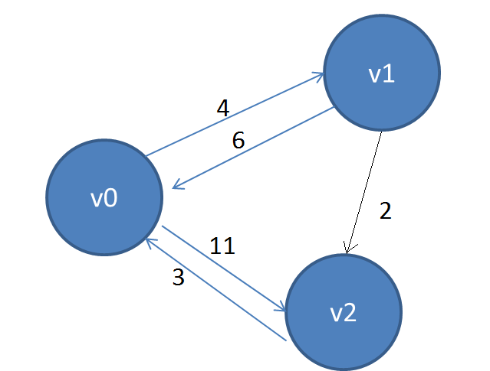
A^{k}[i][j]=min{A^{k-1}[i][j],A^{k-1}[i][k]+A^{k-1}[k][j]},k>=0
A⁻¹[i][j]=cost[i][j].

Slide 26
A-1 | 0 | 1 | 2
0 | 0 | 4 | 11
1 | 6 | 0 | 2
2 | 3 | - | 1
A0 | 0 | 1 | 2
0 | 0 | 4 | 11
1 | 6 | 0 | 2
2 | 3 | 7 | 0
A1 | 0 | 1 | 2
0 | 0 | 4 | 6
1 | 6 | 0 | 2
2 | 3 | 7 | 0
A2 | 0 | 1 | 2
0 | 0 | 4 | 6
1 | 5 | 0 | 2
2 | 3 | 7 | 0

Slide 27
Transitive closure
Suppose we want to determine if there exists a path between i and j for all values of i and j,
Two cases are of interest.
First case is existence of +ve path lenths
Second case is existence of non negative path length.
These cases are known as transitive closure and reflexive transitive closure.

Slide 28
Transitive closure matrix ,denoted by A+ of a directed graph G is a matrix such that A+[i,j]=1 iff there is a path of length >0 between i and j.
Reflexive transitive closure matrix A* of a directed graph G is a matric such that A*[i,j]=1 iff there is a path length >=0 between i and j.
We can compute A+ by allpairs shortest path algorithm

Slide 29
The change required is
Dist[i][j]=Dist[i][j]||Dist[i][k]&&Dist[k][j].
We modify cost such that cost[i][j]=1 if <ij> is an edge and infinity otherwise.
Then we obtain A+[i][j]=1 iff Dist[i][j]<infinity.
We can obtain A* by making all diagnal elements of A+ 1.

Slide 30
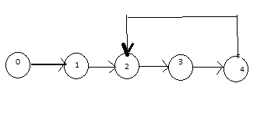
Example
0 | 1 | 0 | 0 | 0
0 | 0 | 1 | 0 | 0
0 | 0 | 0 | 1 | 0
0 | 0 | 0 | 0 | 1
0 | 0 | 1 | 0 | 0
0 | 1 | 1 | 1 | 1
0 | 0 | 1 | 1 | 1
0 | 0 | 1 | 1 | 1
0 | 0 | 1 | 1 | 1
0 | 0 | 1 | 1 | 1
1 | 1 | 1 | 1 | 1
0 | 1 | 1 | 1 | 1
0 | 0 | 1 | 1 | 1
0 | 0 | 1 | 1 | 1
0 | 0 | 1 | 1 | 1
Adj
A+
A*

